Slide 1
Musical instruments in wikidata
LinkedMusic Project Meeting
Kyrie Bouressa
Notes:
Howdy y’all, my name is Kyrie Bouressa. I am a first year Music Tech-Musicology PhD here at McGill in the Distributed Digital Music Archives and Libraries Lab, and I’ve got the pleasure of talkin’ all about musical instruments in wikidata, and some of the unique headaches it has given us as we, or more like I, got my feet under myself and started figuring out just what all is in wikidata, how to sort through and clean it, and locate what we might use. This is shaped in large part by my learning WikiData and SPARQL, which means there are some delightful errors I made in my initial learning that nonetheless revealed some great stuff both about WikiData and my learning SPARQL.

Slide 2
Terminology
Musical Instrument Museum Online (MIMO), Hornbostel-Sachs (HBS), revised HBS (MIMO-HBS)
SPARQL (“sparkle”): query language for retrieving data in a Resource Description Framework (RDF) format- like WikiData!
Q’s and P
Property (P) items: evaluated and moderated
P86 = composer
Entity (Q) items: the Wild West
Q1339 = Johann Sebastian Bach
Instance of (P31) versus subclass of (P279)
Instance: clarinet is an instance of wind instrument (individual item)
Subclass: wind instrument is a subclass of musical instrument (hierarchical relationship)
P31* and P31/P279*
Notes:
Before we go too much further though, I did want to quickly revisit some terminology that I will be using- as with anything there are acronyms aplenty here, and WikiData has some particular terms that are important to remember. The hierarchy we’re initially using as our springboard is that of the Hornbostel Sachs, or HBS, instrument classification hierarchy which was later revised for later instruments and items which didn’t exist in 1931- or at least not in common knowledge. A great example is the addition and expansion of terms to address the variety of ways instruments could be utilized, which could alter their classification- like corporeal or body percussion techniques such as a HAMBONE (next slide)

Slide 3
Steve Hankinson, Hambone artist

Slide 4
Terminology
Musical Instrument Museum Online (MIMO), Hornbostel-Sachs (HBS), revised HBS (MIMO-HBS)
SPARQL (“sparkle”): query language for retrieving data in a Resource Description Framework (RDF) format- like WikiData!
Q’s and P
Property (P) items: evaluated and moderated
P86 = composer
Entity (Q) items: the Wild West
Q1339 = Johann Sebastian Bach
Instance of (P31) versus subclass of (P279)
Instance: clarinet is an instance of woodwind instrument (individual item)
Subclass: wind instrument is a subclass of musical instrument (hierarchical relationship)
P31* and P31/P279*
Notes:
If you’re interested in hamboning, do pull me aside later, it’s got a really interesting history!
Sparql, the query language used for retrieving data from WikiData is highly effective in any kind of Resource Description Framework – or RDF – like DBPedia and other large data projects.
Some of this might be review, but it’s good to have in mind as we proceed because you’re about to see- and hear- a lot of these! Qs and Ps, or entities and properties, are the identifiers through which everything in wikidata are labelled and then retrieved through queries made using SPARQL. P-ids are thoroughly vetted, and are reviewed by the fantastic wiki groups, who also evaluate if they’re too repetitive, narrow, or an existing version is already listed. Q-ids, unfortunately, are not, which means that while some really spectacular items are easily added from a large variety of languages, fields, and interests- it also means they’re a bit of a mess, which I’ll get into shortly.
Phrases that come up a LOT in wikidata, and when querying wikidata, are the phrases ‘instance of’ and ‘subclass of’, both of which let you refine and expand your search in a number of ways- but are immensely confusing to grapple with at first. An instance, at property-31, is a horizontal relationship: a clarinet is an instance of a woodwind instrument, and a wind instrument is part of the vertical hierarchy, a subclass of musical instrument. Does this mean all musical instruments are neatly nestled following this guidance, and that people create and connect instruments correspondingly? Absolutely not.
Now, these little numbers here are fantastic, but really what helps is that little asterisk: the asterisk tells the query service to look not only inside those instances and subclasses, but their neighbors- looking not only inside the ‘woodwind’ box, but down the chain into ‘single reed aerophones’ ‘edge blown flutes’ and so on (just to throw some HBs verbiage into the mix).

Slide 5
Initial query
1
2
3
4
5
Identifier | All | With Image | P31/P279* | With Image
Instrument Family | 722 | 71 | 7070 | 346
Musical Instrument | 144 | 33 | 4713 | 346
Type of Musical Instrument | 428 | 280 | 442 | 280
HBS Item (Q) | 7 | 0 | 7 | 0
Catalogued as HBS (P) | 2372 | 857 | n/a | 857
”Part of” MIMO | 527 | 46 | 565 | 70
A
B
Initial queries primarily Q-based
Q-ids often incomplete or duplicates- not necessarily attached to ‘part of’ or ‘property of’
Easier to find items with greater accuracy with P-based queries, but slower
C
D
E
F
Notes:
Now, what you see on this slide includes a chart- which you don’t need to know too much about, the important things it shows are the initial numbers from our first queries, a really promising 7,000-plus (CLICK), which also all show the difference it makes to query with that little asterisk (CLICK).
What I'm going to lead y'all through is the process through the initial queries in an attempt to get big chunks of data to start cleaning up, and as such a lot of the issues within WikiData were discovered. This was very much a learning process, as I met WikiData and got increasingly better at SPARQL, and started to figure out some of the more interesting quirks of wikidata's collections of musical instruments- which brought me to this initial batch of data. I initially kicked off with q-based queries- looking at musical instruments, types of musical instruments, families of musical instruments, and just about any variation you can think of. I would come to find that certain searches and modifications yielded different results- but really it's in the failure process I learned the most about WikiData and its contents.

Slide 6
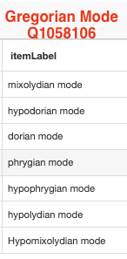
Q problems
Multiple labels for the same item
Incomplete items
modes!
Repeated versions of the same item being counted as its ‘parent’
i.e., a Clarinet in B-flat and a Clarinet in E-flat listed as items separate from Clarinet
Notes:
Because Q-ids can be produced by anyone for essentially any purpose, there are numerous cases of unintentional duplication causing a splitting of reference and resource- a good example here is the modes situation, which as you can see (click) has three authentic and four plagal modes under Gregorian Modes and a pretty braod ranging variety under 'mode' overall, including 'atonality', 'ukrainian dorian scale'and 'tonus pregrinus' among others.
Similarly, there are many, MANY examples where an item will have duplicates of itself- a very common version of this is in examples of transposing instruments. A transposing instrument is certainly still a musical instrument, but is not itself a musical instrument, which results in some misfires, as Ich mentioned in his initial slides. An example here are clarinets- a clarinet in B-flat was entered as a distinct instrument from a clarinet, and an E-flat clarinet listed distinct from both of those.

Slide 7
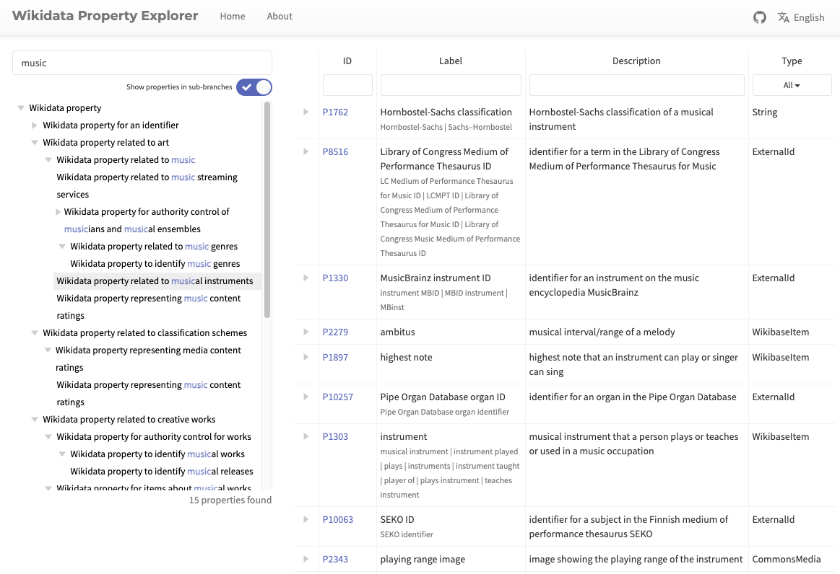
Helpful – navigating properties, finding hierarchies and contributing databases
WikiData Property Explorer Tools
WikiMusic Project
Property Explorer Tools
Notable: https://sqid.toolforge.org/#/view?id=Q34379
https://prop-explorer.toolforge.org/
Means of navigating across available properties and the Q-ids associated with them
Sometimes nested in interesting ways, and helpful to see, given some users utilize them outside of their context (e.g. users connecting ‘instrument of teaching’ property not ‘musical instrument’).
Notes:
Now given the duplication risks that come with a significantly less examined and moderated entity ID, P-ids are very tempting resources for searches- they're moderated, they're nested, and they're usually fairly consistent in their placement in the hierarchy. The problem comes in finding them- unless you happen upon an instrument, like the violin, which has quite a few entires and references, you're not necessarily going to find all potential P-ids you coud use to make your search. Wikidata does, helpfully, have a list of all available property id's- it is in the many thousands long, and does not have obvious indicators to their contents. Fortunately, there are tools folks have built which contain this enformation, such as the squid property explorer, and the prop-explorer.
SQUID reveals something like this (click), and you can navigate throughout these various dropdown and jump between broader and narrower categories- as I have in read here, there are numerous examples of other collections and hierarchies which can and were used in later searches to identify items- but also, in purple, will sometimes reveal instances of a property which is used almost too broadly, or has items linked to it which aren't helpful for us- you're as likely to find a capo in here are you as a drill bit and instrument repair tools.

Slide 8
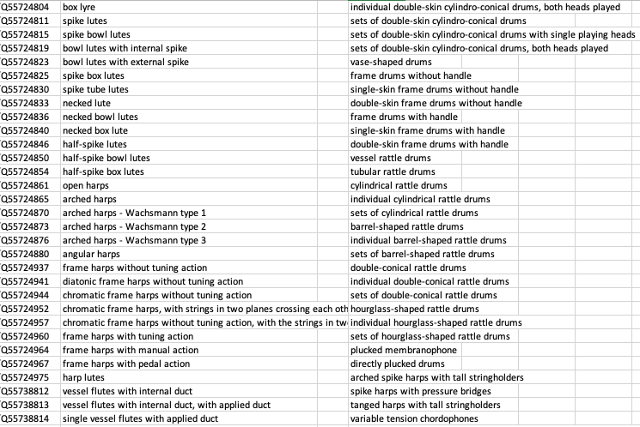
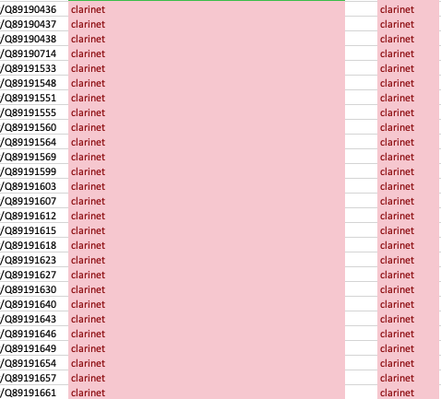
Initial query
7,074 items
Notes:
Now if we think back to that initial 7000+ number we received, going through the data revealed some interesting clues about how people are entering information about musical instruments and otherwise connecting them.
Now, what you're about to see is a list from that initial query, showing the Q-id, the item-label, and and item-family from a general musical instrument query for distinct musical instruments in every category and subcategory- which revealed among other things, every part of the HBS classification system entered as its own distinct musical instrument (CLICK). Of which, I am curious, do any of y'all know the number of categories and subcategories off the top of your head? (306).
Now, if you recall my earlier example about the clarinet- delightfully palatable and easy to digest, it's fairly straightforward how such entries for transposing instruments came to be.
Unfortunately (click) the clarinet exists in many iterations and contexts, all of which were listed as unique musical instruments from one another, as you can see in the left column, identically in label, as you can see in the center here, and uniquely entered as its own instrument family, as you can see on the right. Ultimately, this becomes a problem we can filter for after some trial and error, (which the wonderful DISTINCT qualifier, unfortunately, couldn't immediately discern on my behalf).
The clarinet conundrum is ultimately one of a verity of entries made based on different origins- coming from score labels, band descriptions, ensemble makeups, as well as various versions of the instrument itself, transposing and otherwise.
Nonetheless, problem selves, let's run our adjusted query- (CLICK) The rabbit hole deepens, with 5,733 results like these here. (CLICK --- CLICK) This lone column here, was repeated initially in both columns- QID and itemLabel both read the same QID. In investigating these items I picked up on a recurring theme, revealing a general, two fold issue: the first, a branch from the clarinet conundrum- identical instruments entered as their own distinct instrument. The second, a language issue.
For a reason I am still currently grappling with, and which I would dearly love to hear from y'all about afterwards if any of you have expertise or familiarity in this problem, WikiData has a language skew in its results. Even when you make open ended queries, specifying the language as broadly (a general all, or AUTO_LANGUAGE) or as narrowly as you can think (label by label: english, german, french), there are examples where you will end up with rows upon rows of Qids as labels.(SLIDE)

Slide 9
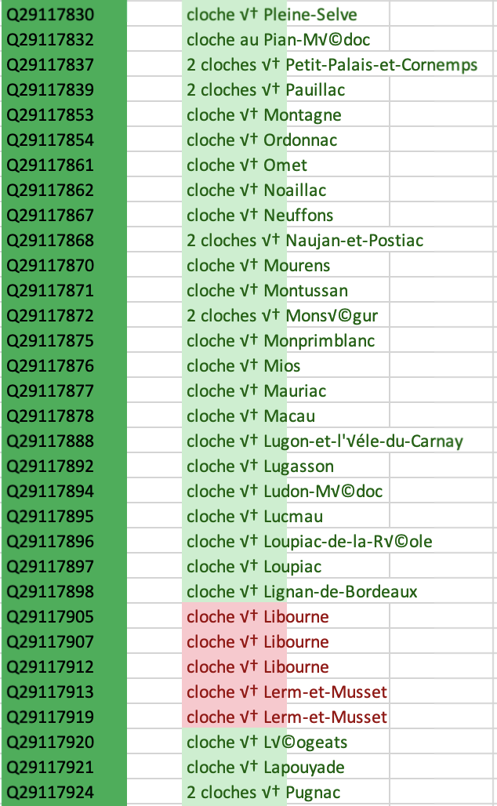
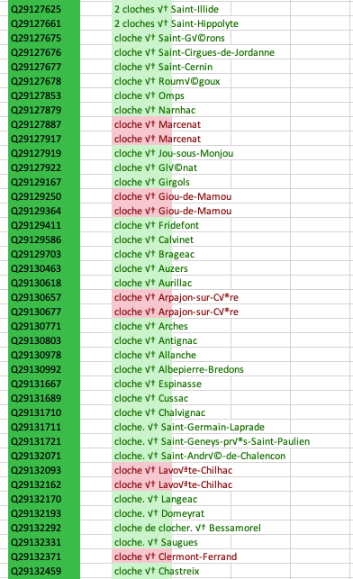
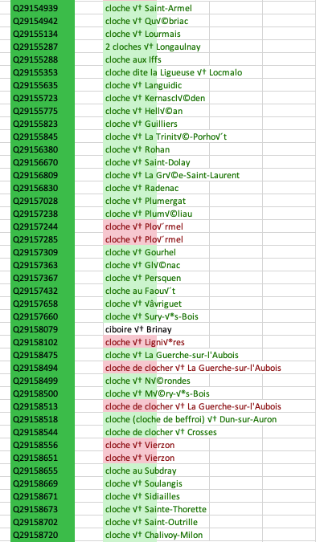
INITIAL
‘fr’ specific
INITIAL
‘fr’ specific
INITIAL
‘fr’ specific
Notes:
These Q-ids would remain until, as I would come to discover, the exact language code the item was created under is searched for and produced (CLICK)- which identified 5,411 of the 5,733 individually catalogued church bells in the Palissy Database (P481) of moveable objects of French cultural heritage.
As you might imagine, this rather knocked some of the wind out of my sails about our spectacular haul of results with images, because yes many of these bells have some really lovely pictures.

Slide 10
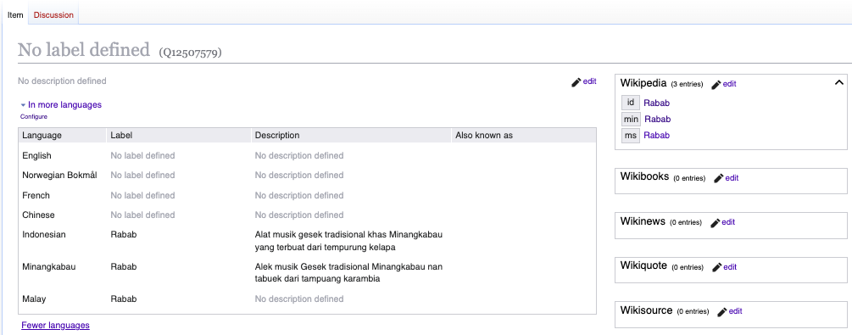
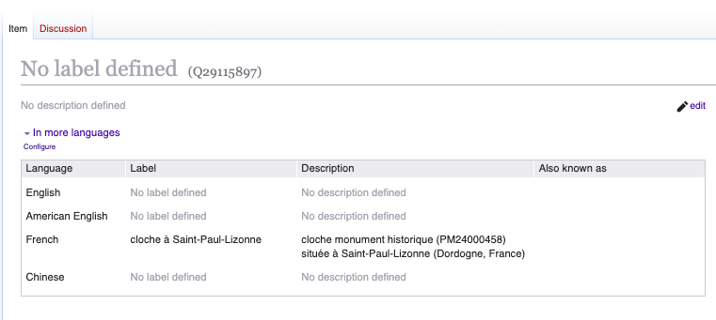
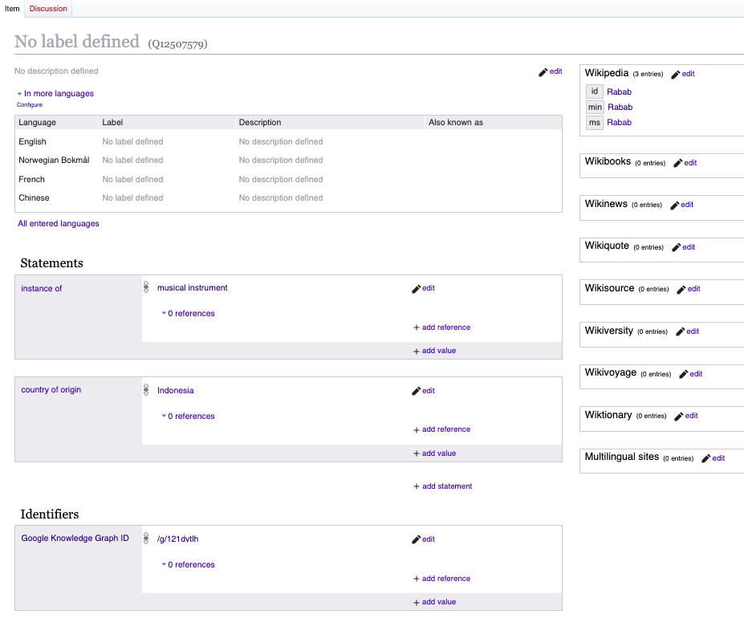
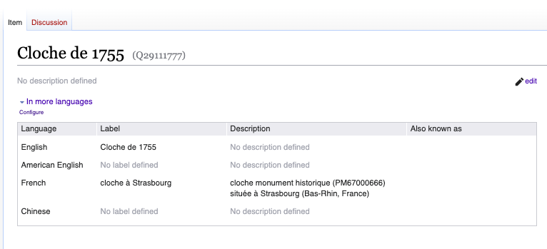
Notes:
Now this language issue would expand in some interesting ways- which is half the fun, rake stepping qualities aside.(click) Some of these items would contain English labels, and would populate, and others wouldn't, but would have their french description in the initial language boxes- but wouldn't directly or easily give a label, even with modified browser settings or query searches.
These examples, however, could be located through their belonging within the 'instance of: bell' section, which traces up the hierarchy to musical instrument AND type of musical instrument (which both have their own separate Q-ids). Not all instruments are so easy to find, or even have a language in the initial language box (click-click).
Here is the Rabab- the name of which we know courtesy of the wikipedia box up in the top right, but has its actual name, pulled from those same wikipedia pages, hidden (click). This initial versus expanded language box issue seems to a prime trouble maker for whether some items will gain a defined label- a problem which has, from what inestigation I've managed to conduct, has a number of edges to it and I'm slowly coming to reckon with, and would LOVE any information any of y'all have on these kinds of language quandries.

Slide 11
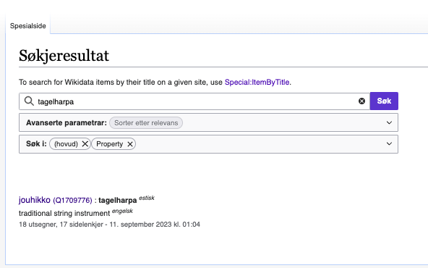
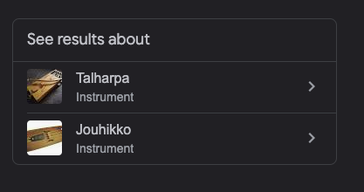
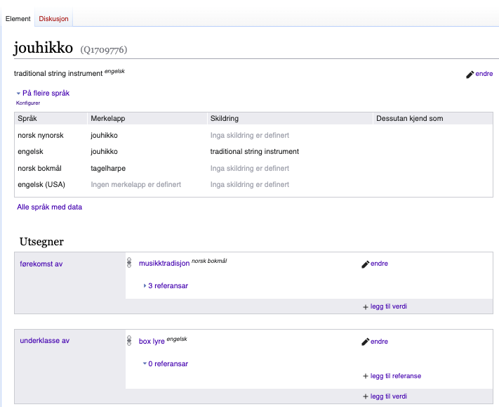
Some problems
A language bias
Multiple associated images can cause duplicate entries
Reliant on users awareness of available material
Items can be pulled from anywhere
Special shoutout to the Google Knowledge Graph API, which will populate ANY truncated google result
Notes:
To recap some of the firehose of information I just threw at you- these Q-ids can be created by anyone. Creators do not necessarily have a complete awareness of existing items, or how to situate items within the wikidata schema, meaning we have some 'floating' examples of musica instruments, families of musical instruments, and so on outside of 'main' trunk of the musical instrument tree.
There is something of a language bias (click)- in some of the ways we've just seen, and it struggles with dialects at times.
It does a very good job at correcting for regional spelling (click-click), which I poked at as shown here, where I tried to maneuver between dialects to see what I could break or get some weird returns, largely as a result of linked pages and individuals adding their languages-
issues arise with individual instruments being created per language, not having linked them to the musical instrument family or discovered the specific language the item was originally listed under (as we saw with the bells), and the user’s search would have populated only an empty Qid, which would have only further prompted a contributor to add the instrument in their language, thus creating multiple distinct items of a same instrument- and if this sounds like a familiar problem, and one which needs solving, in a centralized location where individuals could add names in their languages to an individual entry, have I got great news for you! (click)
What wikidata is talking to to get its information can also sometimes be a culprit- while this is immensely valuable for finding items without defined labels by looking for items with a Wikipedia page, no label, an image, and some kind of relationship to a musical instrument, what happens in some case is that Google, trying to be helpful in so many languages, will respond to a search for an instruments with what it thinks are relvant images, and then will link them to what it thinks the correct article will be. If you’ve ever googled something and gotten this little box (click) there are instances where this API will populate disparate images into Wikidata. This is an area of ongoing puzzlement that I’m trying to get to the root of.

Slide 12
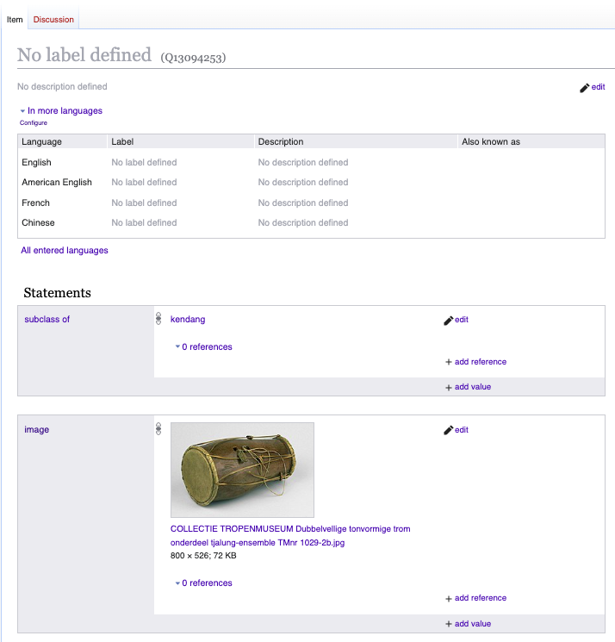
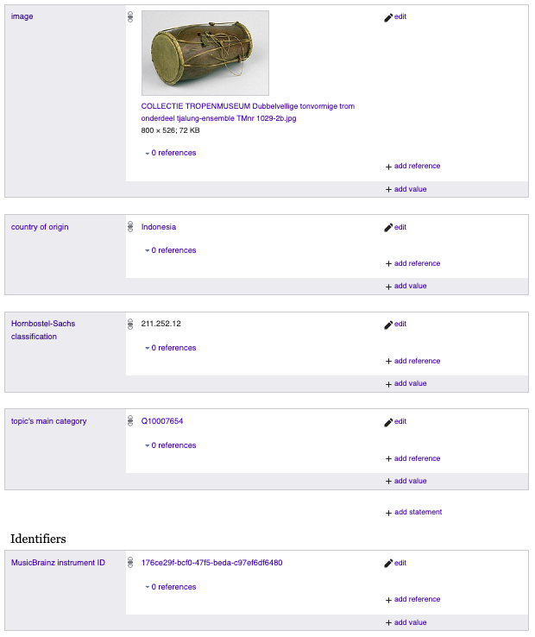
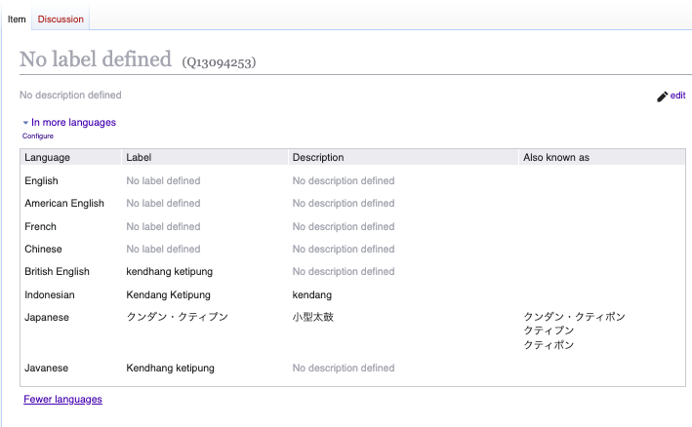
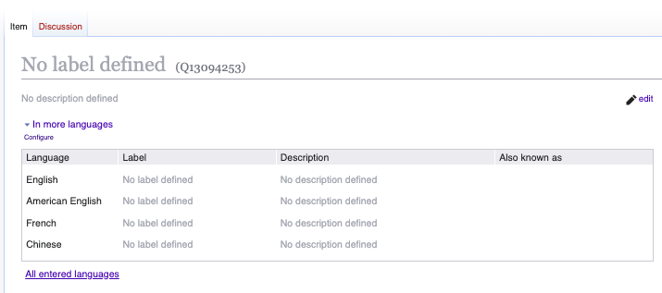
Notes:
Now, here’s an example of paths forward and a couple of the creative ways around the Q-salad. This is Q13094253, or a kendang. Prioritising P searches find items like this a lot faster, and produces lists which can contain information that’s not reliant on user entered data- which can also be a downside, in instances we want localized knowledge or terminology. In finding initial batches of data, however, items which were logged or pulled from existing hierarchies or databases, or contain particular identifiers- like containing an image, or a reference to an instrument- can help us find it. These P-id’s don’t always easy to know they even exist, unless you happen to have a very popular object, like a violin, which will have dozens linked. In this case, the kendang doesn't have a defined label, and suffers from the non-initial language box phenomenon (click---click)
Using those earlier mentioned tools- the SQUID property finder, for example- are great launch points for finding these batches. This item, for example, can be found not through musical instrument, but through by ‘type of’ Indonesian folk instrument, as well as through an HBS search- and it was through (click) a HBS with image search which gave us this item, and within later searches, going through available identifiers with images popped it from Music Brainz as well.

Slide 13
Notes
Fictional instruments are still instruments!
Lack of vetting of Q-id’s impacts searches
“Umbrella” issues
Notes:
There also examples of some other items which show up which weren’t expected- like the horn of gondor, which is indeed a blowing horn and class of wind instrument, and pops up through an HBS query. I

Slide 14
Thank you!

